Slide 1

VE414 Group Project
VE 414 Group3
Dec.5th , 2019
Xia Peiyan, Hu Bingcheng, Zhao Xuanyi
2

Slide 2
Outline
0
PART ZER0
Problem Overview
Data set
Early Estimation
GMM & EM method
Poisson method
Further discussion
1
2

Slide 3
Outline
0
PART ZER0
Problem Overview
Data set
Early Estimation
GMM & EM method
Poisson method
Further discussion
2
2

Slide 4
Problem Overview
1
PART ONE
Invisible trees & visible fruits
Spells that records fruits’ position
Multiple travels
Estimate the number of trees
3
2

Slide 5
Outline
1
PART ONE
Problem Overview
Data set
Early Estimation
GMM & EM method
Poisson method
Further discussion
4
2

Slide 6
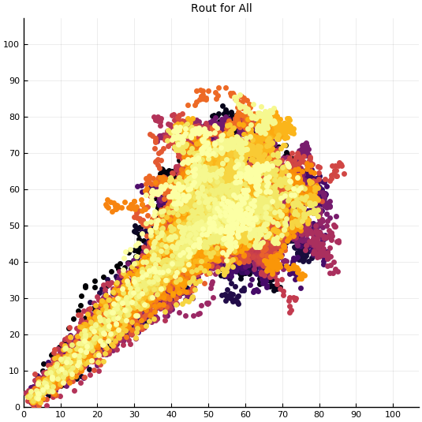
Data Set
2
PART TWO
Basic Info:
107*107 grid
Numbers of fruits within 1 meter
Numbers of fruits within 3 meters
Multiple travels
5
2

Slide 7
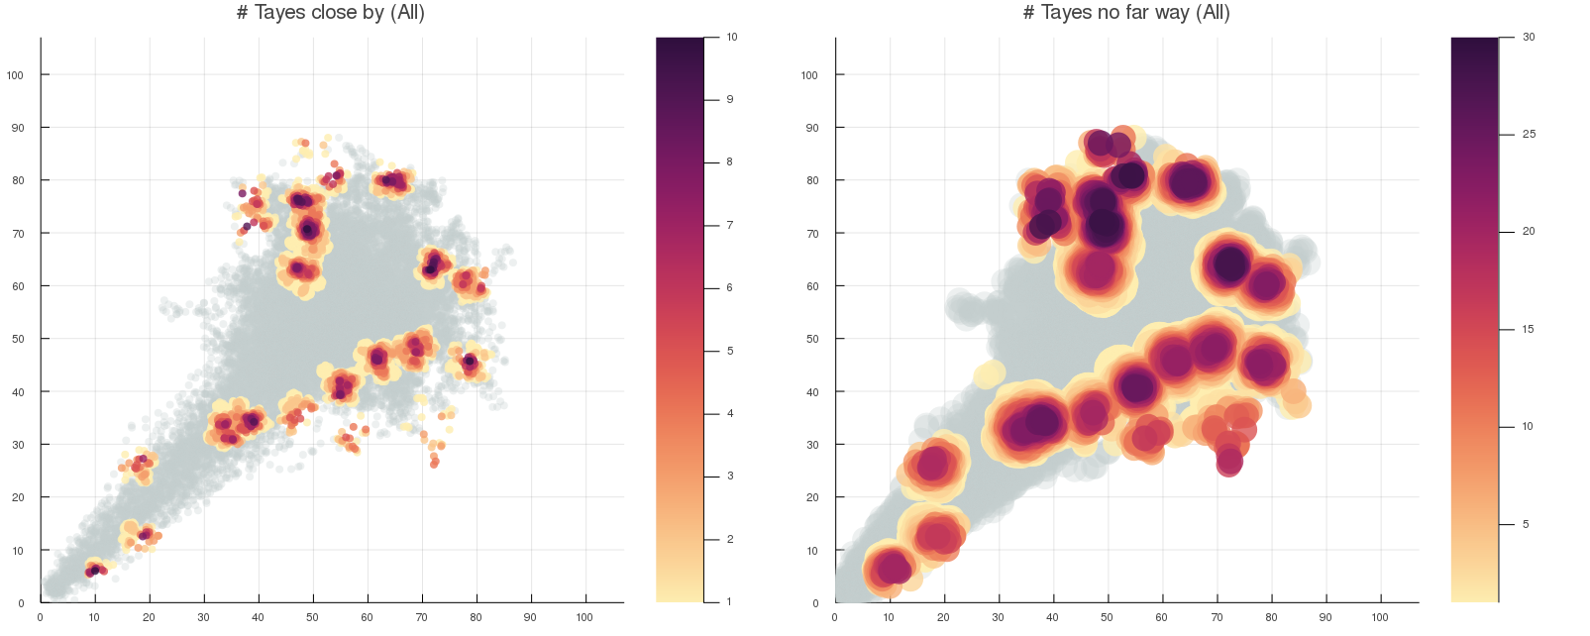
Data Set
2
PART TWO
Graphs of Tayes numbers:
Gray area means no Tayes
Yellow area indicates at least one Taye
Purple area means a lot of Tayes
Intuitively, there should be at least one Jiuling at the center of each cluster
# Tayes close by
# Tayes no far way
One cluster
6
2

Slide 8
Outline
2
PART TWO
Problem Overview
Data set
Early Estimation
GMM & EM method
Poisson method
Further discussion
7
2

Slide 9
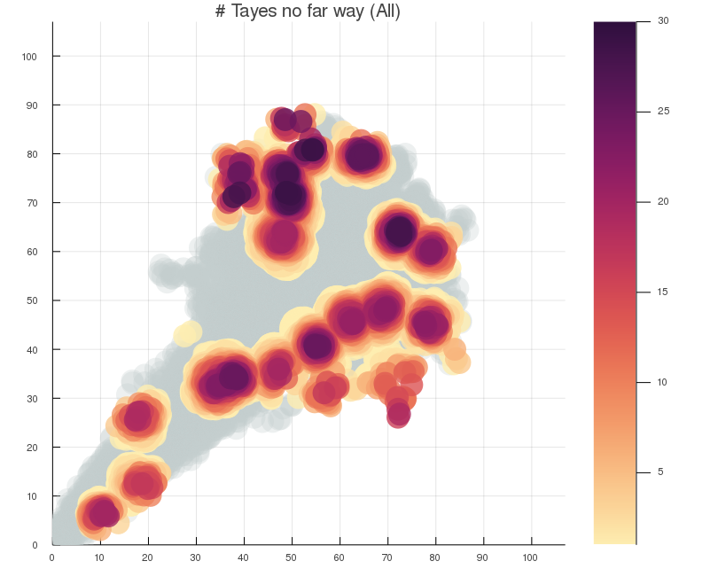
Early Estimation
3
PART THREE
Assumptions:
Take one area as a sample for a single tree
The block with most fruits observed is the tree’s position
The average number of fruits in 1x1 area can be get by calculating the (observed fruits within far distance/observation times)
8
2
Notes:
This means that each data point could have been generated by any of the distributions with a corresponding probability. In effect, each distribution has some ‘responsibility’ for generating a particular data point.

Slide 10
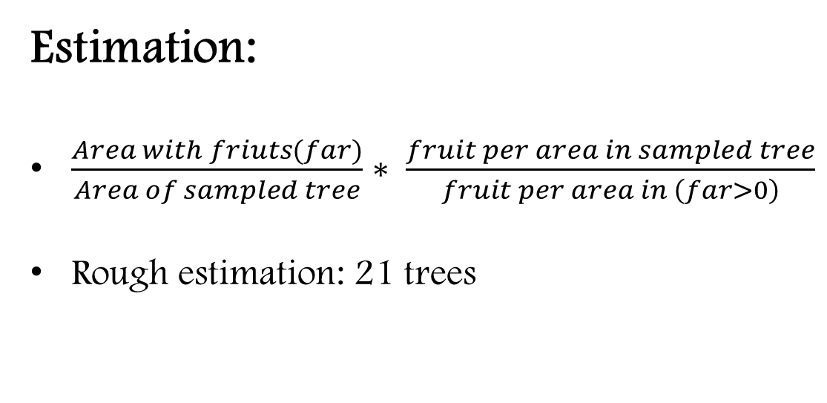
Early Estimation
3
PART THREE
Estimation:
$\frac{Area with friuts(far)}{Area of sampled tree}∗ \frac{fruit per area in sampled tree}{fruit per area in \left(far>0\right)}$
Rough estimation: 21 trees
9
2
Notes:
This means that each data point could have been generated by any of the distributions with a corresponding probability. In effect, each distribution has some ‘responsibility’ for generating a particular data point.

Slide 11
Outline
3
PART THREE
Problem Overview
Data set
Early Estimation
GMM & EM method
Poisson method
Further discussion
10
2

Slide 12
GMM
4
PART FOUR
Intro:
a type of clustering algorithm
each cluster is modelled according to a different Gaussian distribution
soft assignments rather than hard assignments (k-means)
11
2
Notes:
This means that each data point could have been generated by any of the distributions with a corresponding probability. In effect, each distribution has some ‘responsibility’ for generating a particular data point.

Slide 13
GMM
4
PART FOUR
GMM Alogorithm
Introduce a latent variable 𝛾(gamma) for each data point
It assumes that each data point was generated by some information about 𝛾(gamma). It tells us which Gaussian generated a particular data point.
12
2

Slide 14
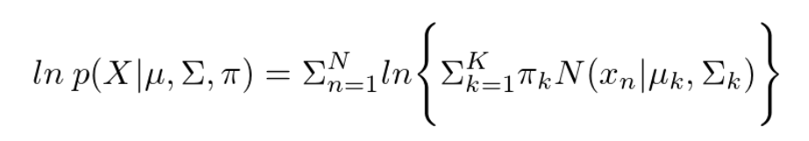
GMM
4
PART FOUR
Goal:
Maximise the marginal likelihood of data points X given our params.
Consider log likelihood of Linear super-position of Gaussians
13
2

Slide 15
EM
4
PART FOUR
However, in practice, we do not observe these latent variables so we need to estimate them.
Expectation Maximisation (EM) Algorithm
14
2

Slide 16

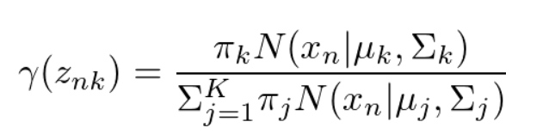
EM
4
PART FOUR
E-STEP:
Recall that
Therefore:
15
2
Notes:
This equation is just Bayes rule where π is the prior weights and the likelihood is normal.

Slide 17
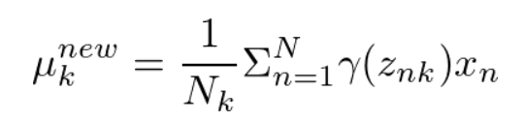
EM
4
PART FOUR
M-STEP:
Loop the steps until convergence.
Mean of the Gaussians
16
2
Notes:
This equation is just Bayes rule where π is the prior weights and the likelihood is normal.

Slide 18
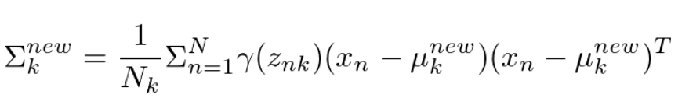
EM
4
PART FOUR
M-STEP:
Loop the steps until convergence.
Covariance of the Gaussians
17
2
Notes:
This equation is just Bayes rule where π is the prior weights and the likelihood is normal.

Slide 19
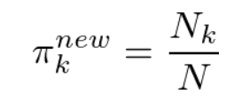

EM
4
PART FOUR
M-STEP:
Loop the steps until convergence.
weights and sum of responsibilities in each Gaussian k
18
2
Notes:
This equation is just Bayes rule where π is the prior weights and the likelihood is normal.

Slide 20
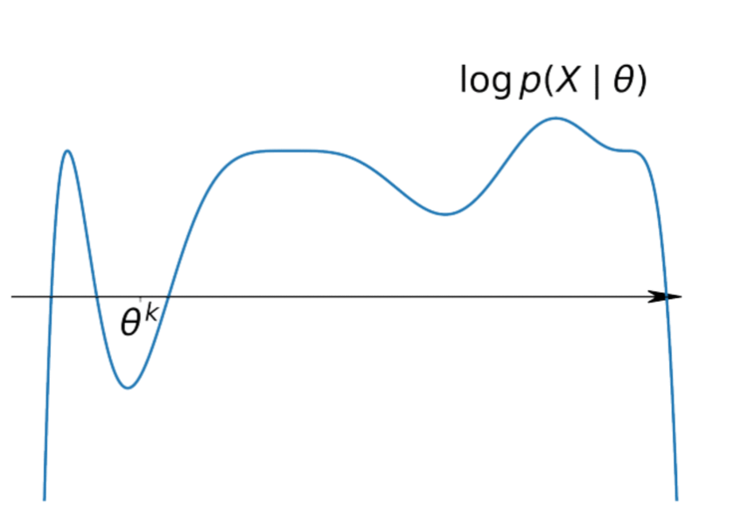
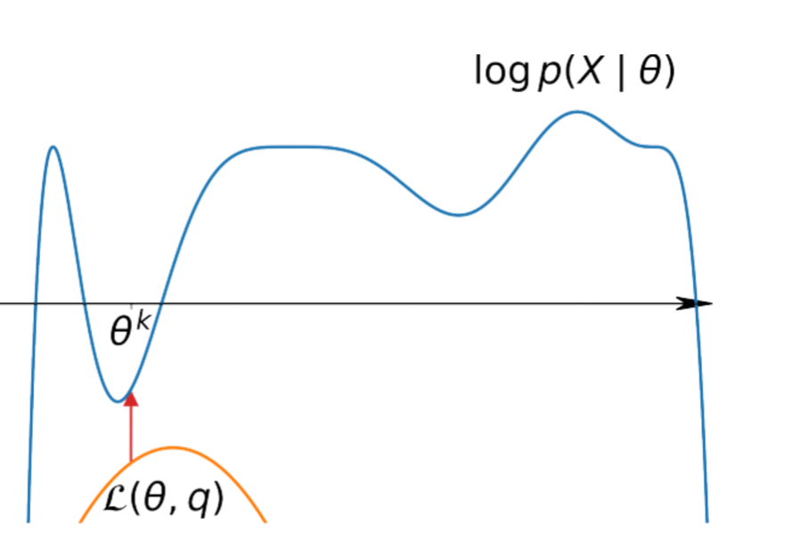
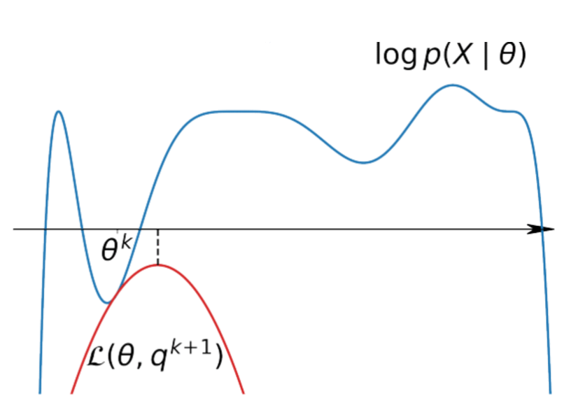
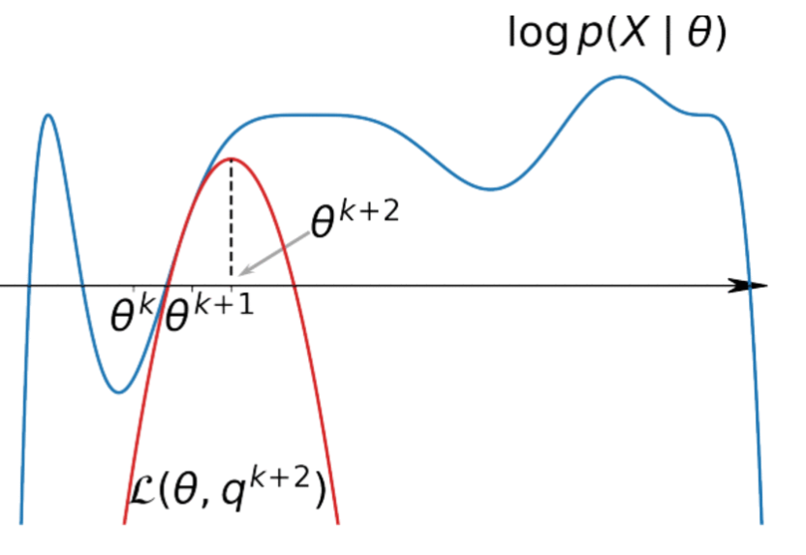
GMM+EM
4
PART FOUR
19
2
Notes:
This equation is just Bayes rule where π is the prior weights and the likelihood is normal.

Slide 21
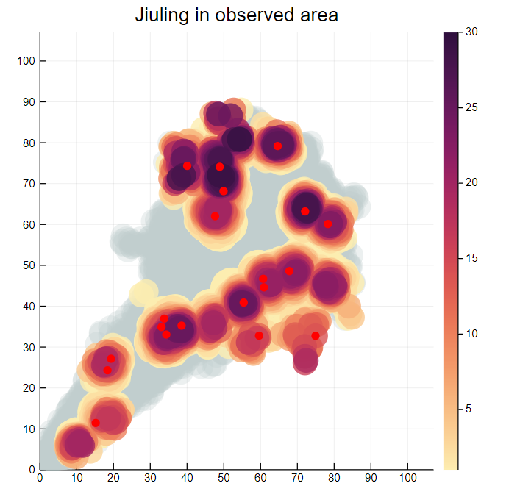
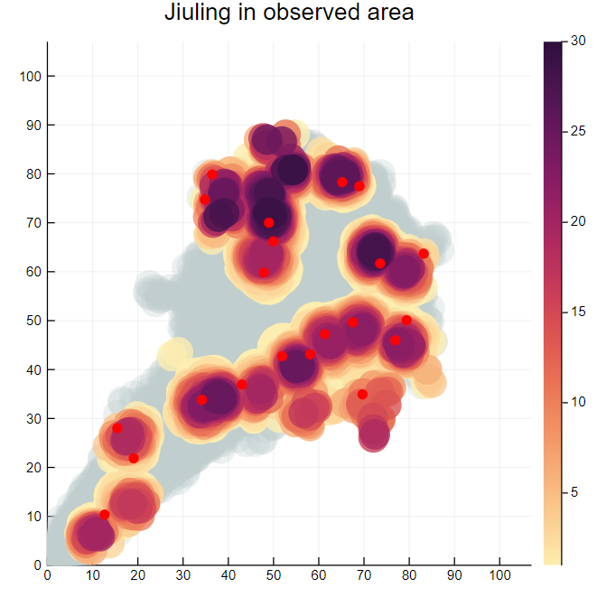
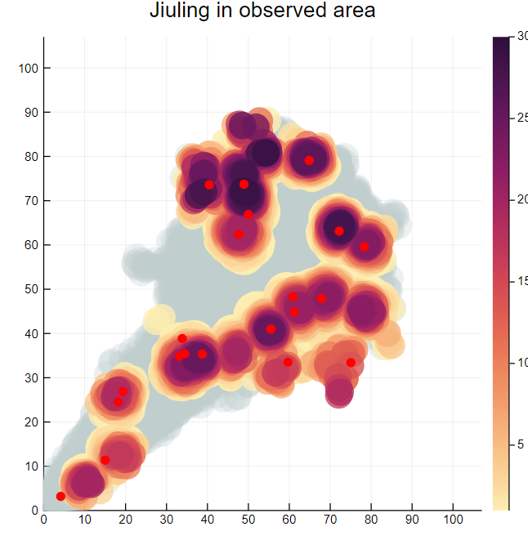
Results
4
PART FOUR
Consider only near data
Consider only far data
Consider weighted sum of near and far data
27
2

Slide 22
Outline
4
PART FOUR
Problem Overview
Data set
Early Estimation
GMM & EM method
Poisson method
Further discussion
20
2

Slide 23
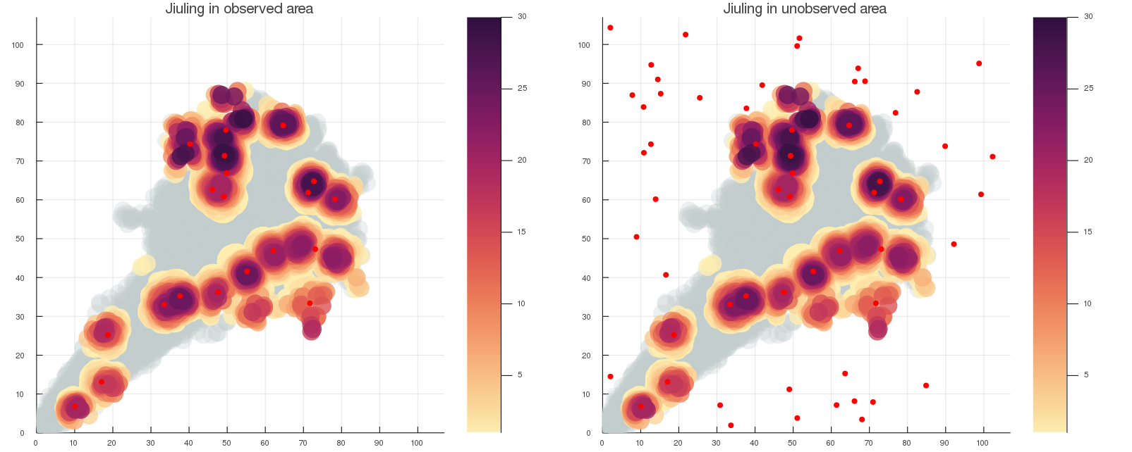
Assumptions
5
PART FIVE
- Two Tayes can live at one position
The center of clusters have different #Tayes
It’s reasonable to consider there are multiple Jiulings
- The probability of the existence of Jiuling is the same inside and outside the observed area - There can not be any Jiuling on the gray area
About 30
About 15
21
2

Slide 24
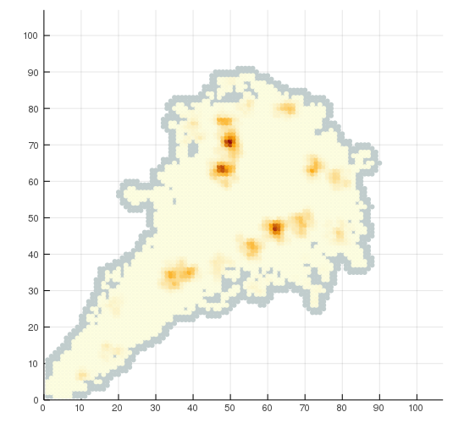

Estimate Grid
5
PART FIVE
Consider the following model of the unobserved area:
$$Xi \sim Poisson\left(λ\right)$$
Where λ is the expectation of a conjugate prior:
$$λ \sim E(Gamma\left(α, β\right))$$
22
2

Slide 25
Random Jiulings
5
PART FIVE
With the estimated Poisson distribution, we estimate the number of trees outside of the observed area
Every turn, the positions are different, but the number of Jiulings are similar
21 observed +37 unobserved
23
2

Slide 26
Outline
5
PART FIVE
Problem Overview
Data set
Early Estimation
GMM & EM method
Poisson method
Further discussion
24
2

Slide 27
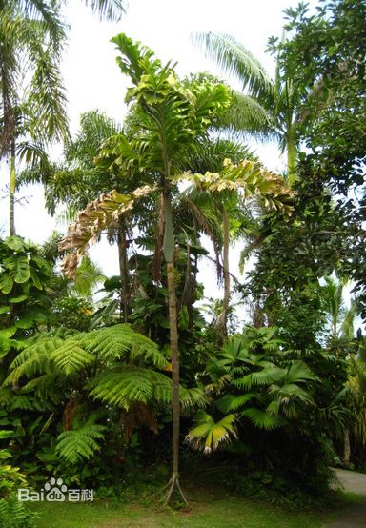
Walking Jiuling
6
PART SIX
What if Jiuling can actually move ?
Just like “Socratea”, which can “walk” 20 meters a year!
Img.baidu.com/KJFSN,98SFU8D
25
2

Slide 28

Walking Jiulings
6
PART SIX
~ Do Jiulings walk or jump?
If they walk, each term there position should be different, so the finding of Tayes should not be clusters
~ Do they choose direction randomly?
~ Is there speed fast or slow?
26
2

Slide 29
Q & A
7
PART SEVEN
28
2

Slide 30
Reference
7
PART SEVEN
https://towardsdatascience.com/gaussian-mixture-modelling-gmm-833c88587c7f
29
2

